Slide 1
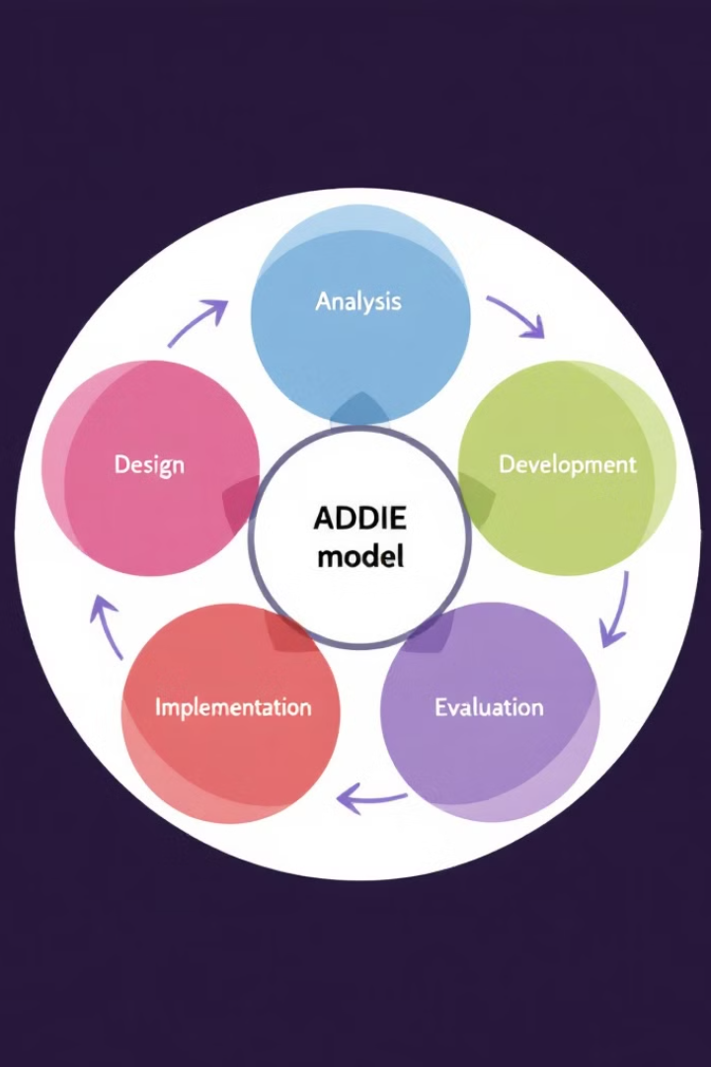

HyperDoc: Exploring the ADDIE Model in Instructional Design
This HyperDoc will guide you through the ADDIE model, a widely used framework for instructional design. You'll learn about each phase and apply it to create your own simple instructional design plan.
by Papia Bawa

Slide 2

Engage: Introduction to ADDIE
1
Watch the Video
Start by watching a short video explaining the ADDIE model.
2
Reflect and Share
In one sentence, describe what ADDIE is and why it's important. Share your thoughts on the discussion board.

Slide 3
Explore: The Five Phases of ADDIE
Interactive Infographic
Jigsaw Activity
Examine an infographic that breaks down the five phases of ADDIE.
Work in small groups to research and summarize one phase of ADDIE. Share your findings with the class using Google Docs or Jamboard.

Slide 4
Explain: Applying ADDIE in Practice
Case Study Analysis
Expert Insights
Read a case study on designing a corporate training program. Identify how ADDIE was used and answer guided questions in a shared Google Doc.
Read an article or listen to a podcast about ADDIE in real-world instructional design. Discuss key takeaways in a group forum.

Slide 5

Apply: Design Your Own Instructional Plan
Choose a Topic
Select a simple topic, such as onboarding new employees or teaching digital literacy.
Outline a Plan
Outline a plan following the ADDIE phases, considering each stage.
Present Your Plan
Present your plan using slides, a short video, or a written document.

Slide 6
Share & Reflect: Peer Review and Exit Ticket
Peer Review
Exit Ticket
Share your mini project with a partner or group. Provide constructive feedback using a checklist.
Reflect on your learning by answering questions about the ADDIE model and its application. Submit your responses in a shared Google Form.

Slide 7

Extend: Optional Enrichment Activities
Explore Other Models
Interview an Expert
Try an alternative instructional design model, such as SAM or Agile, and compare it to ADDIE.
Interview an instructional designer about their use of ADDIE and gain real-world insights.
Share Your Learning
Create a short blog post or infographic summarizing your insights and share your knowledge.

Slide 8

Key Takeaways and Next Steps
1
ADDIE Model
2
Apply Your Learning
The ADDIE model is a structured framework for instructional design, guiding you through five key phases.
Use your newfound knowledge to create effective instructional materials and improve your design skills.
3
Continue Exploring
Explore additional instructional design models and resources to expand your knowledge and skills.

